Slide 1

Topic 3
System Models and Enabling Technologies

Slide 2
Lecture Outline
System Scalability
Amdahl’s Law
System Availability
Single Point of Failure
Security Threats and Defense Technologies
Types of Attacks and Potential Damages
System Attacks and Network Threats
Internet Security Responsibilities
Case Studies

Slide 3
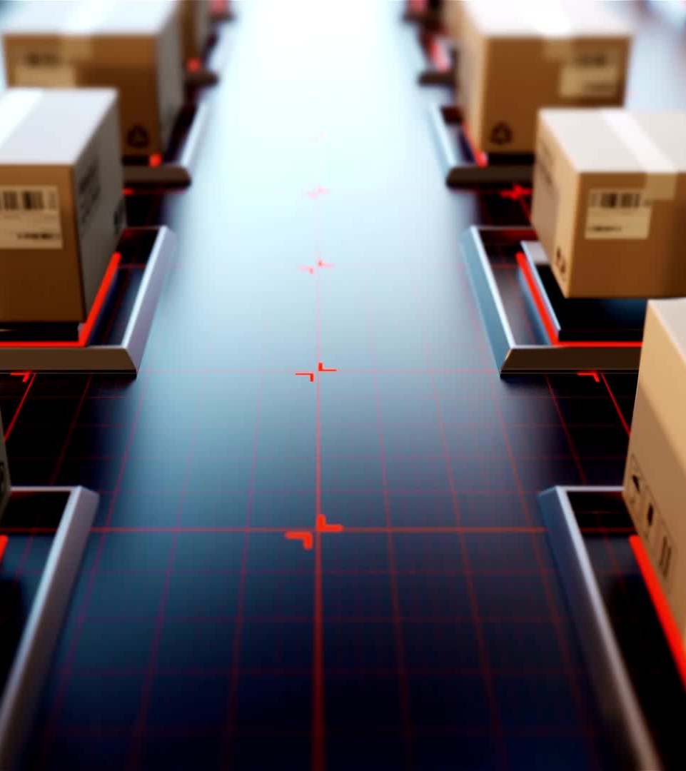
System Scalability
The capability of a system to handle an increasing load or demand without performance degradation.
Importance
Critical for system growth
Improved performance
Long-term sustainability.

Slide 4
Types of Scalability
Vertical Scalability: Enhancing existing resources, such as adding more CPU, RAM, or storage.
Horizontal Scalability: Expanding by adding more servers or devices.
Elastic Scalability: Automatically adjusting resources in response to demand.

Slide 5
Benefits of Scalability
Ensures consistent performance during peak loads.
Reduces system downtime and service disruptions.
Optimizes operational costs by scaling resources as needed.
Supports business growth and user demand.

Slide 6

Amdahl’s Law
Describes the limitations of speedup in parallel computing due to the serial portion of a task.
Formula: Speedup = 1 / (S + (1 - S)/N)
S = Fraction of the workload that must be executed serially
N = Number of processors

Slide 7

Amdahl’s Law
Scenario: A task where 40% is serial and 60% can be parallelized across 4 processors.
Speedup = 1 / (0.4 + (0.6/4)) = 2.22x faster.
Increasing processors has diminishing returns if the serial portion is significant.

Slide 8
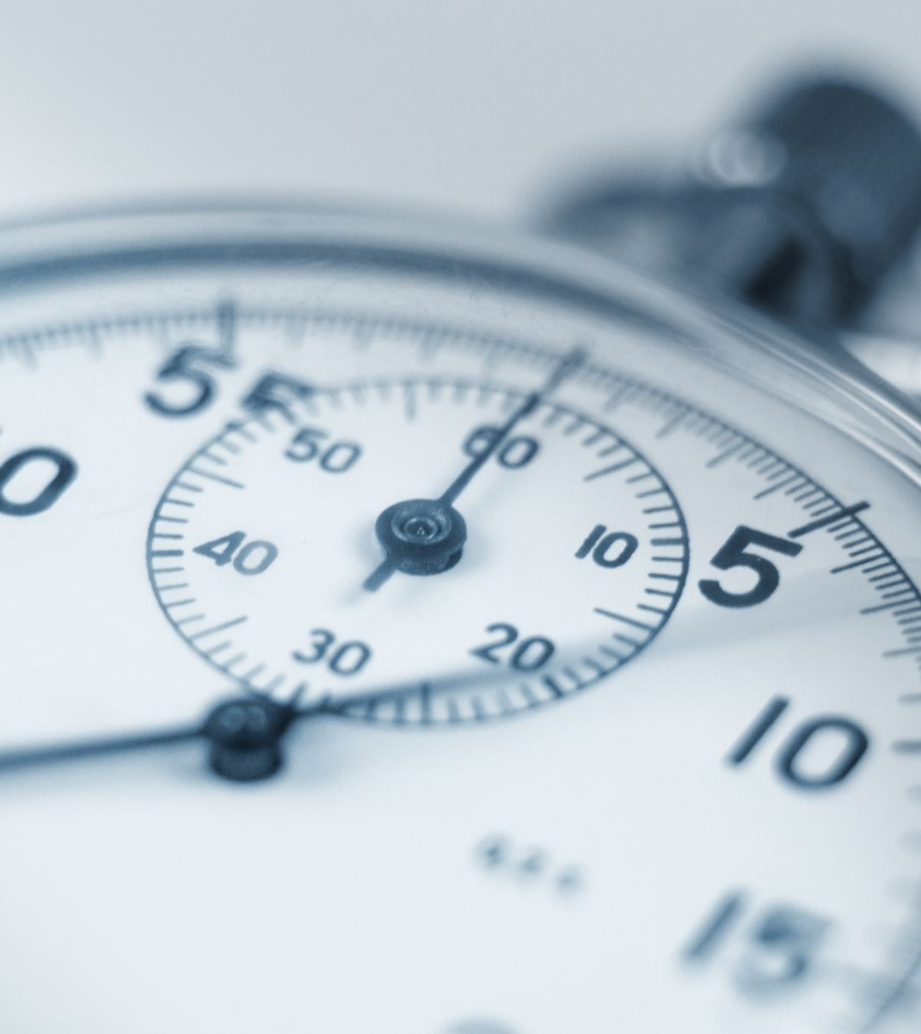
System Availability
The degree to which a system is accessible and functional when needed.
Measured as: Availability (%) = (Uptime / Total Time) * 100

Slide 9
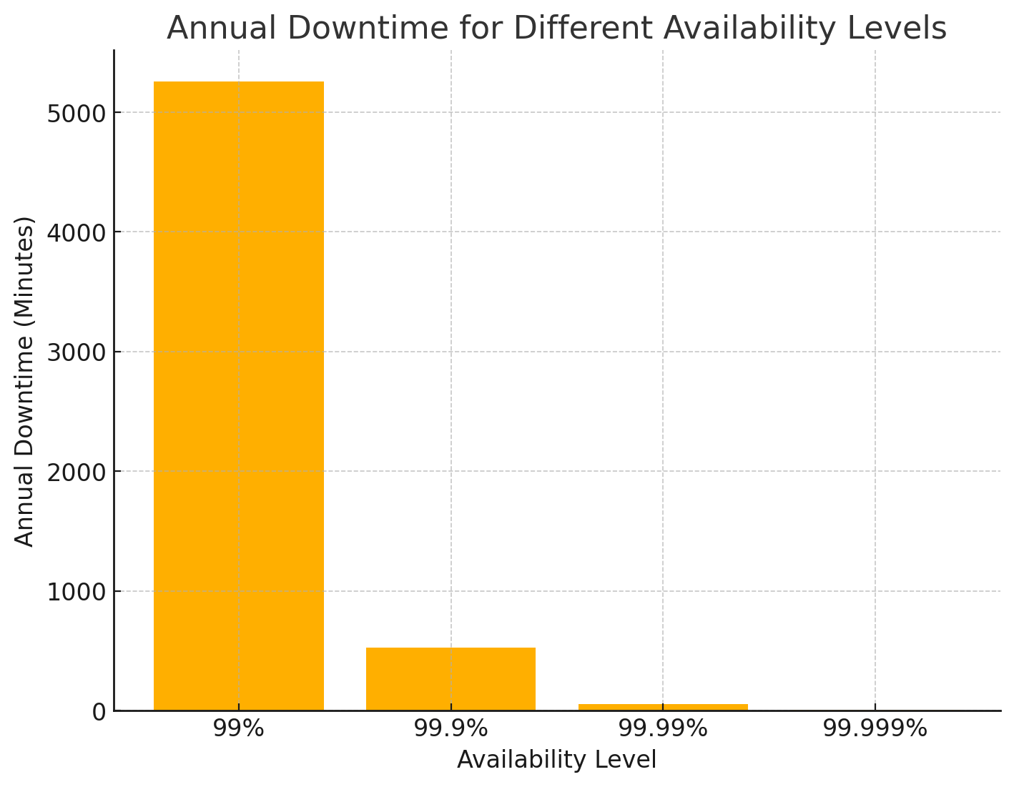
Common Avilability target

Slide 10
Factors Affecting System Availability
Hardware failures
Software bugs and crashes
Network disruptions
Maintenance and upgrades
Disaster events (natural disasters, cyberattacks)

Slide 11
Ensuring High Availability
Redundancy: Use backup components and systems.
Load Balancing: Distribute traffic to avoid overloading servers.
Failover Mechanisms: Automatically switch to standby systems during failures.
Monitoring: Continuous monitoring for quick issue detection.

Slide 12
Single Point of Failure (SPOF)
A component whose failure leads to total system shutdown.
Examples:
Single database server
Central router in a network
Power supply without backup

Slide 13
Mitigating SPOF
Use redundant components and backup systems.
Implement clustering and failover solutions.
Distribute services across multiple data centers.

Slide 14
Security Threats and Defense Technologies
Threats: Actions or events that compromise system integrity, confidentiality, or availability.
Defense Technologies:
Firewalls filter network traffic.
Intrusion Detection Systems (IDS) monitor suspicious activity.
Encryption secures data during transmission and storage.

Slide 15
Types of Security Threats
Malware: Viruses, worms, ransomware
Phishing: Fraudulent emails to steal information
DDoS: Overwhelming systems with excessive traffic
Man-in-the-Middle: Intercepting communications

Slide 16
Potential Damages from Attacks
Data breaches leading to loss of sensitive information
Financial losses due to business disruption
Reputational damage affecting customer trust
Legal consequences from non-compliance

Slide 17
System Attacks
Unauthorized Access: Gaining entry without permission
Privilege Escalation: Increasing access to sensitive areas
Insider Threats: Employees misusing access
Application Vulnerabilities: Exploiting bugs in software

Slide 18
Network Threats to Cyberspace
Packet Sniffing: Capturing data packets during transmission
IP Spoofing: Impersonating trusted devices
DNS Poisoning: Redirecting traffic to malicious sites
Zero-Day Exploits: Attacks exploiting undisclosed vulnerabilities

Slide 19
Defense Against Network Threats
Secure Protocols: Use HTTPS and VPNs for encryption
Network Segmentation: Isolate sensitive systems
Firewalls and IPS: Block unauthorized traffic
Patch Management: Regular software updates

Slide 20
Internet Security Responsibilities
Shared responsibility between individuals, organizations, and governments

Slide 21
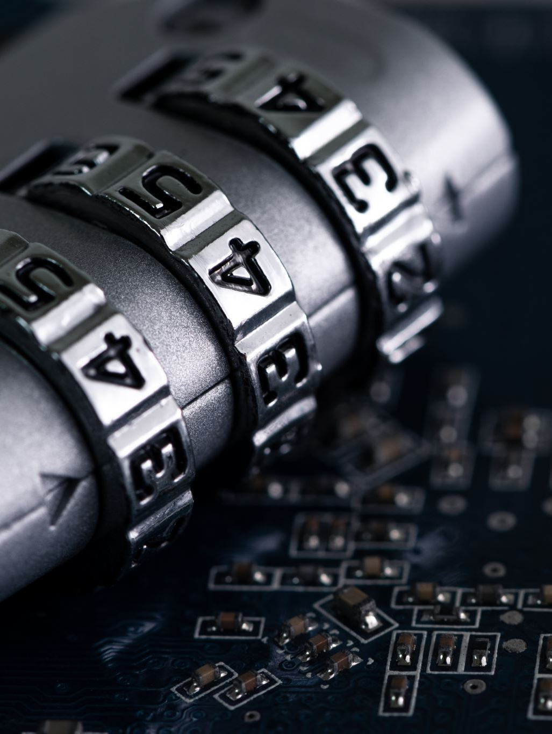
Responsibilities of Individuals
Use strong, unique passwords
Enable two-factor authentication (2FA)
Avoid clicking on suspicious links

Slide 22
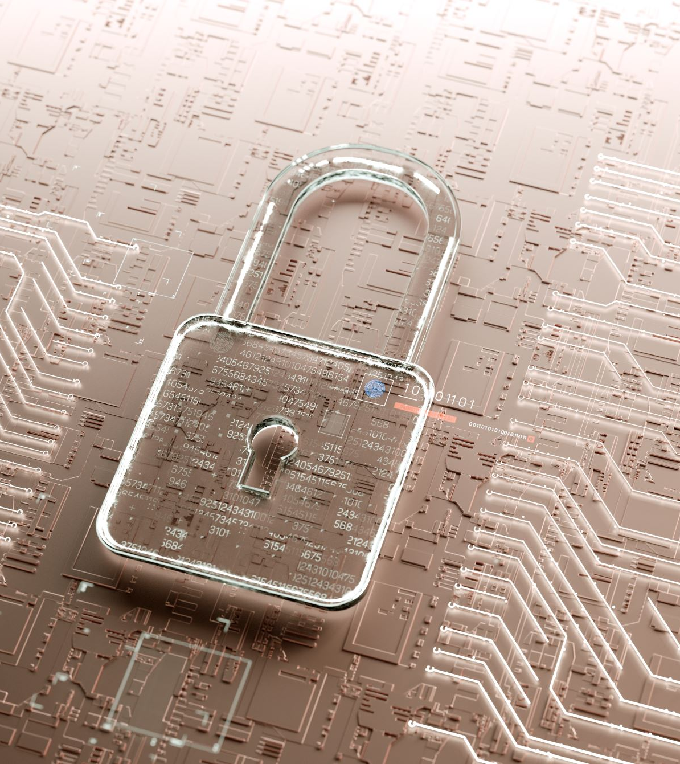
Responsibilities of Organizations
Develop comprehensive cybersecurity policies
Conduct regular employee training
Use encryption to protect data

Slide 23
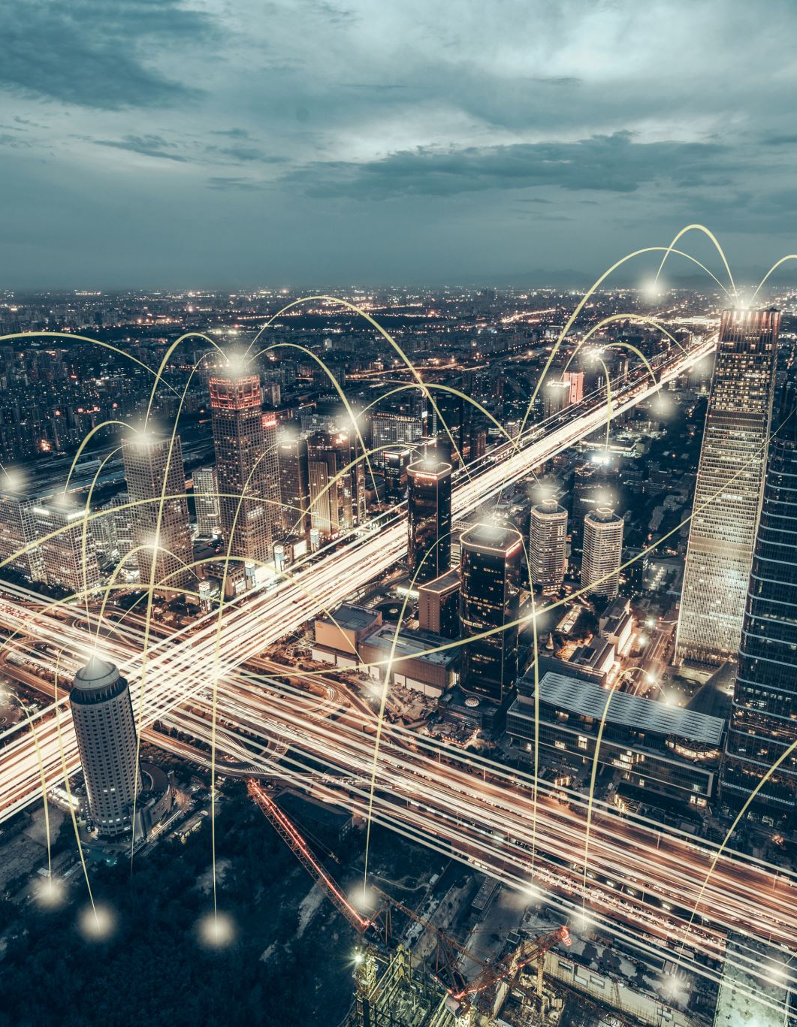
Responsibilities of Governments
Enforce cybersecurity regulations and compliance
Establish national cybersecurity frameworks
Collaborate with international cybersecurity agencies

Slide 24

Case Study 1 - Equifax Data Breach
Event: In 2017, hackers stole sensitive information of 147 million individuals.
Cause: Vulnerability in a web application framework
Impact: Massive financial loss, legal actions, and reputational damage
Lesson: Regular vulnerability assessments and timely patching are critical.

Slide 25

Case Study 2 - WannaCry Ransomware Attack
Event: In 2017, a ransomware worm infected systems globally, encrypting data and demanding ransom payments.
Cause: Exploited a vulnerability in outdated Windows systems
Impact: Affected hospitals, businesses, and government agencies worldwide
Lesson: Keep systems updated and use robust backup solutions

Slide 26
Summary
Scalability and availability are essential for system performance
Amdahl’s Law limits parallel computing benefits
Security threats must be countered with advanced defense technologies
Case studies highlight the importance of proactive cybersecurity

